Slide 1
Data Processing Part III: Pandas and data I/O
Ph.D. Dang Thien Binh
IT Faculty, Da Nang University of Science and Technology

Slide 2
Why pandas?
One of the most popular library that data scientists use
Labeled axes to avoid misalignment of data
Data[:, 2] represents weight or weight2?
When merge two tables, some rows may be different
Missing values or special values may need to be removed or replaced
 | height | Weight | Weight2 | age | Gender
Amy | 160 | 125 | 126 | 32 | 2
Bob | 170 | 167 | 155 | -1 | 1
Chris | 168 | 143 | 150 | 28 | 1
David | 190 | 182 | NA | 42 | 1
Ella | 175 | 133 | 138 | 23 | 2
Frank | 172 | 150 | 148 | 45 | 1
 | salary | Credit score
Alice | 50000 | 700
Bob | NA | 670
Chris | 60000 | NA
David | -99999 | 750
Ella | 70000 | 685
Tom | 45000 | 660

Slide 3
Overview
Created by Wes McKinney in 2008, now maintained by Jeff Reback and many others.
Author of one of the textbooks: Python for Data Analysis
Powerful and productive Python data analysis and Management Library
Panel Data System
Its an open source product.

Slide 4
Overview - 2
Python Library to provide data analysis features similar to: R, MATLAB, SAS
Rich data structures and functions to make working with data structure fast, easy and expressive.
It is built on top of NumPy
Key components provided by Pandas:
Series
DataFrame
From now on:
In [664]: from pandas import Series, DataFrame
In [665]: import pandas as pd

Slide 5
Series
One dimensional array-like object
It contains array of data (of any NumPy data type) with associated indexes. (Indexes can be strings or integers or other data types.)
By default , the series will get indexing from 0 to N where N = size -1
In [666]: obj = Series([4, 7, -5, 3])
In [667]: obj
Out[667]:
0 4
1 7
2 -5
3 3
dtype: int64
In [668]: obj.values
Out[668]: array([ 4, 7, -5, 3], dtype=int64)
In [669]: obj.index
Out[669]: RangeIndex(start=0, stop=4, step=1)

Slide 6
Series – referencing elements
In [818]: obj2.a
Out[818]: -5
In [670]: obj2 = Series([4, 7, -5, 3], index=['d', 'b', 'a', 'c'])
In [671]: obj2
Out[671]:
d 4
b 7
a -5
c 3
dtype: int64
In [674]: obj2['a']
Out[674]: -5
In [675]: obj2['d']=10
In [677]: obj2[['d', 'c', 'a']]
Out[677]:
d 10
c 3
a -5
dtype: int64
In [672]: obj2.index
Out[672]: Index(['d', 'b', 'a', 'c'], dtype='object')
In [673]: obj2.values
Out[673]: array([ 4, 7, -5, 3], dtype=int64)
In [692]: obj2[:2]
Out[692]:
d 10
b 7
dtype: int64

Slide 7
Series – array/dict operations
numpy array operations can also be applied, which will preserve the index-value link
Can be thought of as a dict. Can be constructed from a dict directly.
In [699]: obj2**2
Out[699]:
d 100
b 49
a 25
c 9
dtype: int64
In [694]: obj2[obj2>0]
Out[694]:
d 10
b 7
c 3
dtype: int64
In [702]: obj3 = Series({'a': 10, 'b': 5, 'c': 30})
In [703]: obj3
Out[703]:
a 10
b 5
c 30
dtype: int64
In [700]: 'b' in obj2
Out[700]: True

Slide 8
Series – null values
In [708]: pd.isnull(obj4)
Out[708]:
Texas False
Ohio False
Oregon False
Iowa True
dtype: bool
In [704]: sdata = {'Texas': 10, 'Ohio': 20, 'Oregon': 15, 'Utah': 18}
In [705]: states = ['Texas', 'Ohio', 'Oregon', 'Iowa']
In [706]: obj4 = Series(sdata, index=states)
In [707]: obj4
Out[707]:
Texas 10.0
Ohio 20.0
Oregon 15.0
Iowa NaN
dtype: float64
In [709]: pd.notnull(obj4)
Out[709]:
Texas True
Ohio True
Oregon True
Iowa False
dtype: bool
Missing value
In [717]: obj4[obj4.notnull()]
Out[717]:
Texas 10.0
Ohio 20.0
Oregon 15.0
dtype: float64

Slide 9
Series – auto alignment
In [715]: obj5 + obj4
Out[715]:
Iowa NaN
Ohio 40.0
Oregon 30.0
Texas 20.0
Utah NaN
dtype: float64
In [707]: obj4
Out[707]:
Texas 10.0
Ohio 20.0
Oregon 15.0
Iowa NaN
dtype: float64
In [714]: obj5
Out[714]:
Ohio 20
Oregon 15
Texas 10
Utah 18
dtype: int64

Slide 10
Series name and index name
In [722]: obj4.index.name = 'state'
In [723]: obj4
Out[723]:
state
Texas 10.0
Ohio 20.0
Oregon 15.0
Iowa NaN
Name: population, dtype: float64
In [720]: obj4.name = 'population'
In [721]: obj4
Out[721]:
Texas 10.0
Ohio 20.0
Oregon 15.0
Iowa NaN
Name: population, dtype: float64
In [725]: obj4.index = ['Florida', 'New York', 'Kentucky', 'Georgia']
In [726]: obj4
Out[726]:
Florida 10.0
New York 20.0
Kentucky 15.0
Georgia NaN
Name: population, dtype: float64
Index of a series can be changed to a different index.
Index object itself is immutable.
In [1014]: obj4.index[2]='California'
TypeError: Index does not support mutable operations
In [1016]: obj4.index
Out[1016]: Index(['Florida', 'New York', 'Kentucky', 'Georgia'], dtype='object')

Slide 11
DataFrame
In [727]: data = {'state': ['Ohio', 'Ohio', 'Ohio', 'Nevada', 'Nevada'],
...: 'year': [2000, 2001, 2002, 2001, 2002],
...: 'pop': [1.5, 1.7, 3.6, 2.4, 2.9]}
In [728]: frame = DataFrame(data)
In [729]: frame
Out[729]:
pop state year
0 1.5 Ohio 2000
1 1.7 Ohio 2001
2 3.6 Ohio 2002
3 2.4 Nevada 2001
4 2.9 Nevada 2002
A DataFrame is a tabular data structure comprised of rows and columns, akin to a spreadsheet or database table.
It can be treated as an order collection of columns
Each column can be a different data type
Have both row and column indices
reordered

Slide 12
DataFrame – specifying columns and indices
In [727]: data = {'state': ['Ohio', 'Ohio', 'Ohio', 'Nevada', 'Nevada'],
...: 'year': [2000, 2001, 2002, 2001, 2002],
...: 'pop': [1.5, 1.7, 3.6, 2.4, 2.9]}
Order of columns/rows can be specified.
Columns not in data will have NaN.
In [730]: frame2 = DataFrame(data, columns=['year', 'state', 'pop', 'debt'], index=['A', 'B', 'C', 'D', 'E'])
In [731]: frame2
Out[731]:
year state pop debt
A 2000 Ohio 1.5 NaN
B 2001 Ohio 1.7 NaN
C 2002 Ohio 3.6 NaN
D 2001 Nevada 2.4 NaN
E 2002 Nevada 2.9 NaN
Same order
Initialized with NaN

Slide 13
DataFrame – from nested dict of dicts
Outer dict keys as columns and inner dict keys as row indices
In [838]: pop = {'Nevada': {2001: 2.9, 2002: 2.9}, 'Ohio': {2002: 3.6, 2001: 1.7, 2000: 1.5}}
In [840]: frame3 = DataFrame(pop)
In [841]: frame3
Out[841]:
Nevada Ohio
2000 NaN 1.5
2001 2.9 1.7
2002 2.9 3.6
Transpose
In [842]: frame3.T
Out[842]:
2000 2001 2002
Nevada NaN 2.9 2.9
Ohio 1.5 1.7 3.6
Union of inner keys (in sorted order)

Slide 14
DataFrame – index, columns, values
In [850]: frame3.index.name = 'year'; frame3.columns.name='state'
In [851]: frame3
Out[851]:
state Nevada Ohio
year
2000 NaN 1.5
2001 2.9 1.7
2002 2.9 3.6
In [847]: frame3.index
Out[847]: Int64Index([2000, 2001, 2002], dtype='int64')
In [848]: frame3.columns
Out[848]: Index(['Nevada', 'Ohio'], dtype='object')
In [849]: frame3.values
Out[849]:
array([[NaN, 1.5],
[ 2.9, 1.7],
[ 2.9, 3.6]])

Slide 15
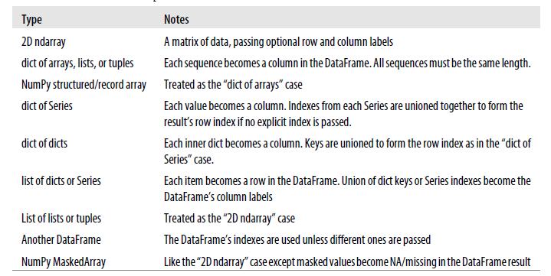
Possible data inputs to DataFrame constructor

Slide 16
Indexing, selection and filtering
Series and DataFrame can be sliced/accessed with label-based indexes, or using position-based indexes similar to Numpy Array
In [906]: S = Series(range(4), index=['zero', 'one', 'two', 'three'])
In [907]: S['two']
Out[907]: 2
In [908]: S[['zero', 'two']]
Out[908]:
zero 0
two 2
dtype: int32
In [911]: S[:2]
Out[911]:
zero 0
one 1
dtype: int32
In [917]: S[S > 1]
Out[917]:
two 2
three 3
dtype: int32
In [909]: S[2]
Out[909]: 2
In [910]: S[[0,2]]
Out[910]:
zero 0
two 2
dtype: int32
In [913]: S['zero':'two']
Out[913]:
zero 0
one 1
two 2
dtype: int32
In [995]: S[-2:]
Out[995]:
two 2
three 3
dtype: int32
Inclusive

Slide 17
DataFrame – retrieving a column
A column in a DataFrame can be retrieved as a Series by dict-like notation or as attribute
Series index and name have been kept/set appropriately
In [734]: frame['state']
Out[734]:
0 Ohio
1 Ohio
2 Ohio
3 Nevada
4 Nevada
Name: state, dtype: object
In [733]: frame.state
Out[733]:
0 Ohio
1 Ohio
2 Ohio
3 Nevada
4 Nevada
Name: state, dtype: object
In [805]: type(frame['state'])
Out[805]: pandas.core.series.Series

Slide 18
DataFrame – getting rows
loc for using indexes and iloc for using positions
In [819]: frame2.loc[['A', 'B']]
Out[819]:
year state pop debt
A 2000 Ohio 1.5 NaN
B 2001 Ohio 1.7 NaN
In [820]: type(frame2.loc[['A', 'B']])
Out[820]: pandas.core.frame.DataFrame
In [792]: frame2
Out[792]:
year state pop debt
A 2000 Ohio 1.5 NaN
B 2001 Ohio 1.7 NaN
C 2002 Ohio 3.6 NaN
D 2001 Nevada 2.4 NaN
E 2002 Nevada 2.9 NaN
In [801]: frame2.loc['A']
Out[801]:
year 2000
state Ohio
pop 1.5
debt NaN
Name: A, dtype: object
In [804]: type(frame2.loc['A'])
Out[804]: pandas.core.series.Series

Slide 19
DataFrame – modifying columns
In [829]: frame2['debt'] = 0
In [830]: frame2
Out[830]:
year state pop debt
A 2000 Ohio 1.5 0
B 2001 Ohio 1.7 0
C 2002 Ohio 3.6 0
D 2001 Nevada 2.4 0
E 2002 Nevada 2.9 0
In [831]: frame2['debt'] = range(5)
In [832]: frame2
Out[832]:
year state pop debt
A 2000 Ohio 1.5 0
B 2001 Ohio 1.7 1
C 2002 Ohio 3.6 2
D 2001 Nevada 2.4 3
E 2002 Nevada 2.9 4
In [833]: val = Series([10, 10, 10], index = ['A', 'C', 'D'])
In [834]: frame2['debt'] = val
In [835]: frame2
Out[835]:
year state pop debt
A 2000 Ohio 1.5 10.0
B 2001 Ohio 1.7 NaN
C 2002 Ohio 3.6 10.0
D 2001 Nevada 2.4 10.0
E 2002 Nevada 2.9 NaN
Rows or individual elements can be modified similarly. Using loc or iloc.

Slide 20
DataFrame – removing columns
In [836]: del frame2['debt']
In [837]: frame2
Out[837]:
year state pop
A 2000 Ohio 1.5
B 2001 Ohio 1.7
C 2002 Ohio 3.6
D 2001 Nevada 2.4
E 2002 Nevada 2.9

Slide 21
More on DataFrame indexing
In [871]: frame[['c1', 'c3']]
Out[871]:
c1 c3
r1 0 2
r2 3 5
r3 6 8
In [855]: data = np.arange(9).reshape(3,-1)
In [856]: data
Out[856]:
array([[0, 1, 2],
[3, 4, 5],
[6, 7, 8]])
In [870]: frame['c1']
Out[870]:
r1 0
r2 3
r3 6
Name: c1, dtype: int32
In [879]: frame.loc[['r1','r3']]
Out[879]:
c1 c2 c3
r1 0 1 2
r3 6 7 8
In [878]: frame.loc['r1']
Out[878]:
c1 0
c2 1
c3 2
Name: r1, dtype: int32
In [885]: frame.iloc[:2]
Out[885]:
c1 c2 c3
r1 0 1 2
r2 3 4 5
In [868]: frame = DataFrame(data, index=['r1', 'r2', 'r3'], columns=['c1', 'c2', 'c3'])
In [869]: frame
Out[869]:
c1 c2 c3
r1 0 1 2
r2 3 4 5
r3 6 7 8
Row slices
In [954]: frame[:2]
Out[954]:
c1 c2 c3
r1 0 1 2
r2 3 4 5
In [952]: frame['c1']['r1']
Out[952]: 0
Row slices

Slide 22
More on DataFrame indexing - 2
In [1027]: frame.loc[['r1', 'r2'], ['c1', 'c2']]
Out[1027]:
c1 c2
r1 0 1
r2 3 4
In [1140]: v = DataFrame(np.arange(9).reshape(3,3), index=['a', 'a', 'b'], columns=['c1','c2','c3'])
In [1141]: v
Out[1141]:
c1 c2 c3
a 0 1 2
a 3 4 5
b 6 7 8
In [1142]: v.loc['a']
Out[1142]:
c1 c2 c3
a 0 1 2
a 3 4 5
Duplicated keys
In [1034]: frame.loc['r1':'r3', 'c1':'c3']
Out[1034]:
c1 c2 c3
r1 0 1 2
r2 3 4 5
r3 6 7 8
In [1036]: frame.iloc[:2,:2]
Out[1036]:
c1 c2
r1 0 1
r2 3 4

Slide 23
More on DataFrame indexing - 3
In [980]: frame
Out[980]:
c1 c2 c3
r1 0 1 2
r2 3 4 5
r3 6 7 8
In [981]: frame[frame['c1']>0]
Out[981]:
c1 c2 c3
r2 3 4 5
r3 6 7 8
In [982]: frame['c1']>0
Out[982]:
r1 False
r2 True
r3 True
Name: c1, dtype: bool
In [1038]: frame < 3
Out[1038]:
c1 c2 c3
r1 True True True
r2 False False False
r3 False False False
In [987]: frame[frame<3] = 3
In [988]: frame
Out[988]:
c1 c2 c3
r1 3 3 3
r2 3 4 5
r3 6 7 8

Slide 24
Removing rows/columns
In [899]: frame.drop(['r1'])
Out[899]:
c1 c2 c3
r2 3 4 5
r3 6 7 8
In [900]: frame.drop(['r1','r3'])
Out[900]:
c1 c2 c3
r2 3 4 5
In [901]: frame.drop(['c1'], axis=1)
Out[901]:
c2 c3
r1 1 2
r2 4 5
r3 7 8
This returns a new object (MATLAB-like).
In [1050]: frame
Out[1050]:
c1 c2 c3
r1 0 1 2
r2 3 4 5
r3 6 7 8

Slide 25
Reindexing
Alter the order of rows/columns of a DataFrame or order of a series according to new index
In [887]: frame
Out[887]:
c1 c2 c3
r1 0 1 2
r2 3 4 5
r3 6 7 8
In [888]: frame.reindex(['r1', 'r3', 'r2', 'r4'])
Out[889]:
c1 c2 c3
r1 0.0 1.0 2.0
r3 6.0 7.0 8.0
r2 3.0 4.0 5.0
r4 NaN NaN NaN
In [892]: frame.reindex(columns=['c2', 'c3', 'c1'])
Out[892]:
c2 c3 c1
r1 1 2 0
r2 4 5 3
r3 7 8 6
This returns a new object (MATLAB-like).

Slide 26
Function application and mapping
DataFrame.applymap(f) applies f to every entry
DataFrame.apply(f) applies f to every column (default) or row
In [1087]: frame
Out[1087]:
c1 c2 c3
r1 0 1 2
r2 3 4 5
r3 6 7 8
In [1084]: def max_minus_min(x): return max(x)-min(x)
In [1085]: frame.apply(max_minus_min)
Out[1085]:
c1 6
c2 6
c3 6
dtype: int64
In [1077]: def square(x): return x**2
In [1078]: frame.applymap(square)
Out[1078]:
c1 c2 c3
r1 0 1 4
r2 9 16 25
r3 36 49 64
In [1086]: frame.apply(max_minus_min, axis=1)
Out[1086]:
r1 2
r2 2
r3 2
dtype: int64

Slide 27
Function application and mapping - 2
In [1088]: def max_min(x): return Series([max(x), min(x)], index=['max', 'min'])
In [1089]: frame.apply(max_min)
Out[1089]:
c1 c2 c3
max 6 7 8
min 0 1 2

Slide 28
Other DataFrame functions
sort_index()
sort_values()
In [1094]: frame = DataFrame(np.random.randint(0, 10, 9).reshape(3,-1), index=['r1', 'r2', 'r3'], columns=['c1', 'c2', 'c3'])
In [1095]: frame
Out[1095]:
c1 c2 c3
r1 8 3 9
r2 2 5 0
r3 4 4 8
In [1090]: frame.index=['A', 'C', 'B']; frame.columns=['b','a','c'];
In [1091]: frame.sort_index()
Out[1091]:
b a c
A 0 1 2
B 6 7 8
C 3 4 5
In [1092]: frame.sort_index(axis=1)
Out[1092]:
a b c
A 1 0 2
C 4 3 5
B 7 6 8
In [1102]: frame.sort_values(axis=1,by=['r3','r1'])
Out[1102]:
c2 c1 c3
r1 3 8 9
r2 5 2 0
r3 4 4 8
In [1101]: frame.sort_values(by='c1')
Out[1101]:
c1 c2 c3
r2 2 5 0
r3 4 4 8
r1 8 3 9

Slide 29
Other DataFrame functions - 2
Rank()
In [1106]: frame
Out[1106]:
c1 c2 c3
r1 8 3 9
r2 2 5 0
r3 4 4 8
In [1107]: frame.rank(axis=1)
Out[1107]:
c1 c2 c3
r1 2.0 1.0 3.0
r2 2.0 3.0 1.0
r3 1.5 1.5 3.0
Frame[‘c1’][‘r1’] is the second smallest in r1
Frame[‘c1’][‘r3’] and Frame[‘c2’][‘r3’] is tied for the smallest in r3

Slide 30
Other DataFrame functions
mean()
Mean(axis=0, skipna=True)
sum()
cumsum()
describe(): return summary statistics of each column
for numeric data: mean, std, max, min, 25%, 50%, 75%, etc.
For non-numeric data: count, uniq, most-frequent item, etc.
corr(): correlation between two Series, or between columns of a DataFrame
corr_with(): correlation between columns of DataFram and a series or between the columns of another DataFrame

Slide 31
Handling missing data
In [1198]: from numpy import nan as NaN
In [1199]: data = Series([1, NaN, 2.5, NaN, 6])
In [1200]: data.dropna()
Out[1200]:
0 1.0
2 2.5
4 6.0
dtype: float64
In [1201]: data
Out[1201]:
0 1.0
1 NaN
2 2.5
3 NaN
4 6.0
dtype: float64
Filtering out missing values
In [1204]: data.notnull()
Out[1204]:
0 True
1 False
2 True
3 False
4 True
dtype: bool
In [1205]: data[data.notnull()]
Out[1205]:
0 1.0
2 2.5
4 6.0
dtype: float64

Slide 32
Handling missing data - 2
In [1215]: data[4]=NaN
In [1216]: data
Out[1216]:
0 1 2 4
0 1.0 2.0 3.0 NaN
1 1.0 NaN NaN NaN
2 NaN NaN NaN NaN
3 NaN 4.0 5.0 NaN
In [1217]: data.dropna(axis=1, how='all')
Out[1217]:
0 1 2
0 1.0 2.0 3.0
1 1.0 NaN NaN
2 NaN NaN NaN
3 NaN 4.0 5.0
In [1206]: data = DataFrame([[1, 2, 3], [1, NaN, NaN], [NaN, NaN, NaN], [NaN, 4, 5]])
In [1207]: data
Out[1207]:
0 1 2
0 1.0 2.0 3.0
1 1.0 NaN NaN
2 NaN NaN NaN
3 NaN 4.0 5.0
In [1208]: data.dropna()
Out[1208]:
0 1 2
0 1.0 2.0 3.0
In [1209]: data.dropna(how='all')
Out[1209]:
0 1 2
0 1.0 2.0 3.0
1 1.0 NaN NaN
3 NaN 4.0 5.0
In [1210]: data.dropna(axis=1, how='all')
Out[1210]:
0 1 2
0 1.0 2.0 3.0
1 1.0 NaN NaN
2 NaN NaN NaN
3 NaN 4.0 5.0

Slide 33
Filling in missing data
In [1227]: data
Out[1227]:
0 1 2
0 NaN 9 9.0
1 NaN 7 2.0
2 4.0 8 9.0
3 3.0 4 NaN
In [1228]: data.fillna(data.mean(skipna=True))
Out[1228]:
0 1 2
0 3.5 9 9.000000
1 3.5 7 2.000000
2 4.0 8 9.000000
3 3.0 4 6.666667
In [1218]: data
Out[1218]:
0 1 2 4
0 1.0 2.0 3.0 NaN
1 1.0 NaN NaN NaN
2 NaN NaN NaN NaN
3 NaN 4.0 5.0 NaN
In [1219]: data.fillna(0)
Out[1219]:
0 1 2 4
0 1.0 2.0 3.0 0.0
1 1.0 0.0 0.0 0.0
2 0.0 0.0 0.0 0.0
3 0.0 4.0 5.0 0.0
Modify the dataframe instead of retunring a new object (default)
In [1220]: data.fillna(0, inplace=True)
In [1221]: data
Out[1221]:
0 1 2 4
0 1.0 2.0 3.0 0.0
1 1.0 0.0 0.0 0.0
2 0.0 0.0 0.0 0.0
3 0.0 4.0 5.0 0.0
replace nan with column mean

Slide 34
Hierarchical indexing
In [1229]: dataSeries = Series(np.arange(10), index=[['a']*3+['b']*3+['c']*4, [‘i’,’ii’,’iii’]*3+[‘iv’]])
In [1230]: dataSeries
Out[1230]:
a i 0
ii 1
iii 2
b i 3
ii 4
iii 5
c i 6
ii 7
iii 8
iv 9
dtype: int32
In [1240]: dataSeries.index
Out[1240]:
MultiIndex(levels=[['a', 'b', 'c'], ['i', 'ii', 'iii', 'iv']],
labels=[[0, 0, 0, 1, 1, 1, 2, 2, 2, 2], [0, 1, 2, 0, 1, 2, 0, 1, 2, 3]])
In [1242]: dataSeries['b']
Out[1242]:
i 3
ii 4
iii 5
dtype: int32
In [1243]: dataSeries[:, 'ii']
Out[1243]:
a 1
b 4
c 7
dtype: int32
MultiIndex

Slide 35
Hierarchical indexing and DataFrame
Unstack and stack
In [1245]: dataSeries.unstack()
Out[1245]:
i ii iii iv
a 0.0 1.0 2.0 NaN
b 3.0 4.0 5.0 NaN
c 6.0 7.0 8.0 9.0
In [1246]: dataSeries.unstack().T.stack()
Out[1246]:
i a 0.0
b 3.0
c 6.0
ii a 1.0
b 4.0
c 7.0
iii a 2.0
b 5.0
c 8.0
iv c 9.0
dtype: float64

Slide 36
Hierarchical indexing for DataFrame
In [1256]: frame2 = DataFrame(np.arange(16).reshape(4,4), index=[['a', 'a', 'b', 'b'], ['i','ii']*2], columns=[['c1', 'c1', 'c2', 'c2'], ['.1', '.2']*2])
In [1257]: frame2
Out[1257]:
c1 c2
.1 .2 .1 .2
a i 0 1 2 3
ii 4 5 6 7
b i 8 9 10 11
ii 12 13 14 15
In [1274]: frame2.swaplevel(-2, -1)
Out[1274]:
c1 c2
.1 .2 .1 .2
i a 0 1 2 3
ii a 4 5 6 7
i b 8 9 10 11
ii b 12 13 14 15
In [1275]: frame2.swaplevel(-2, -1, axis=1)
Out[1275]:
.1 .2 .1 .2
c1 c1 c2 c2
a i 0 1 2 3
ii 4 5 6 7
b i 8 9 10 11
ii 12 13 14 15

Slide 37
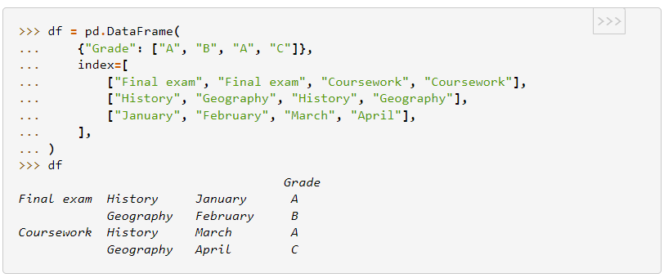
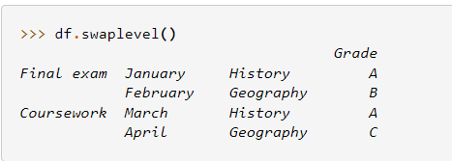
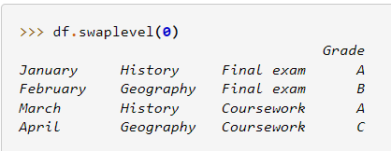
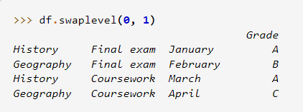
Hierarchical indexing for DataFrame

Slide 38
Use DataFrame columns as indices
set_index
In [1281]: df = DataFrame({'a':range(7), 'b':range(7,0,-1), 'c':['one']*3+['two']*4, 'd':[0,1,2]*2+[3]})
In [1282]: df
Out[1282]:
a b c d
0 0 7 one 0
1 1 6 one 1
2 2 5 one 2
3 3 4 two 0
4 4 3 two 1
5 5 2 two 2
6 6 1 two 3
In [1283]: df2=df.set_index(['c', 'a'])
In [1284]: df2
Out[1284]:
b d
c a
one 0 7 0
1 6 1
2 5 2
two 3 4 0
4 3 1
5 2 2
6 1 3
In [1285]: df2.loc['one']
Out[1285]:
b d
a
0 7 0
1 6 1
2 5 2

Slide 39
Data loading, storage and file formats

Slide 40
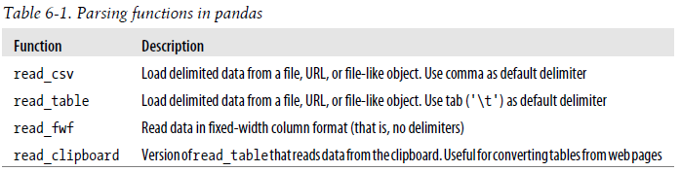
Text format
Essentially the same. Use different delimiter by default, but can supply delimiter as a parameter.
read_csv
read_table

Slide 41
Features
Indexing: can treat one or more columns as indexes of the returned DataFrame, and whether to get column names from the file, the user or not at all
Type inference and data conversion. Includes user-defined value conversion and custom list of missing value markers
No need to specify between float, int, str, and bool
Datetime parsing. Combining date and time info from multiple columns into a single column.
Iterating: support for iterating over chunks of very large files.
Unclean data issue: skipping header rows or footer, comments, etc.

Slide 42
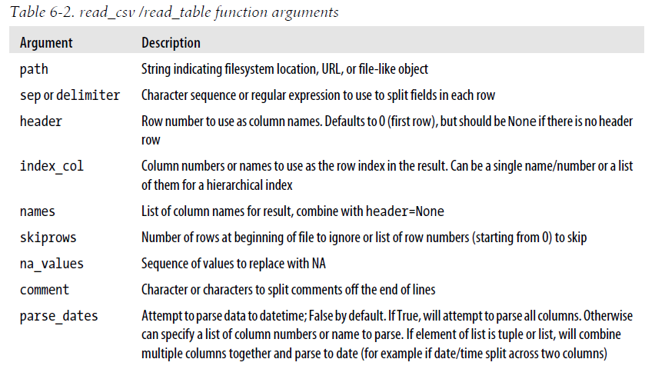

Slide 43
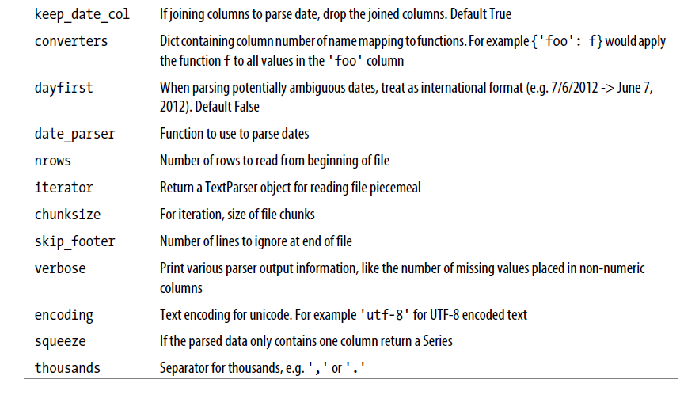

Slide 44
Writing data to text format
to_csv(path)
Signature: to_csv(path_or_buf=None, sep=',', na_rep='', float_format=None, columns=None, header=True, index=True, index_label=None, mode='w', encoding=None, compression=None, quoting=None, quotechar='"', line_terminator='\n', chunksize=None, tupleize_cols=False, date_format=None, doublequote=True, escapechar=None, decimal='.')

Slide 45
JSON format
obj = """
{"name": "Wes",
"places_lived": ["United States", "Spain", "Germany"],
"pet": null,
"siblings": [{"name": "Scott", "age": 30, "pets": ["Zeus", "Zuko"]},
{"name": "Katie", "age": 38,
"pets": ["Sixes", "Stache", "Cisco"]}]
}
"""
JSON: JavaScript Object Notation
One of the standard formats for sending data by HTTP requests
Eg:
Very similar to python syntax. However, strings must be enclosed in “double quotes” instead of ‘single quotes’.
Can have dicts, lists, strings, numbers, booleans, and nulls
json.loads() converts a json-format string to a python object (e.g, dict or list)
json.dump() converts a python object to a json-format string
pandas.read_json() read json format file to DataFrame
data.to_json(): converts a DataFrame to a json string

Slide 46
XML and HTML parsing
lxml library
lxml.html for html
lxml.objectify for xml
pandas.read_html(path): read html tables into a list of DataFrames

Slide 47
Binary data format
“pickle” format
dataframe.to_pickle(path) saves a DataFrame into binary format
pandas.read_pickle(picklefile) reads a pickle file into a DataFrame
HDF5 format (Hierarchical Data Format)
store = pd.HDFStore(path)
store[‘key’] = obj
store.close() # save objects into file
store.open()
store.select(objName, start=0, stop = n)
pd.read_hdf(path, objName, start=0, stop = n)
HDF5 lets you store huge amounts of numerical data, and easily manipulate that data from NumPy. For example, you can slice into multi-terabyte datasets stored on disk, as if they were real NumPy arrays. Thousands of datasets can be stored in a single file, categorized and tagged however you want.

Slide 48
Interacting with Database
sqlite3 to create a light-weight database
sqlalchemy to access database and retrieve records as python objects
pandas.read_sql to read table into DataFrame

Slide 49
Data transformation and normalization
Use boxplot to take a quick look
Transform data to obtain a certain distribution
e.g. from lognormal to normal
Normalize data so different columns became comparable / compatible
Typical normalization approach:
Z-score transformation
Scale to between 0 and 1
Trimmed mean normalization
Vector length transformation
Quantilenorm

Slide 50
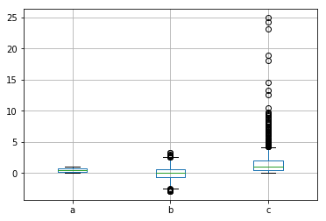
Boxplot example
In [1867]: df=DataFrame({'a': np.random.rand(1000), 'b': np.random.randn(1000, ), 'c': np.random.lognormal(size=(1000,))})
In [1868]: df.head()
Out[1868]:
a b c
0 0.356627 1.406655 3.288161
1 0.472792 -1.247858 2.499727
2 0.467848 0.406503 2.215045
3 0.341257 1.457440 0.390666
4 0.236013 0.026771 1.295106
In [1869]: df.boxplot()
Out[1869]: <matplotlib.axes._subplots.AxesSubplot at 0x4dfb0f28>

Slide 51

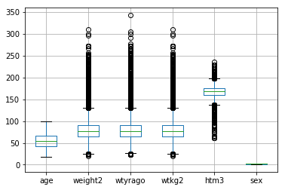
Boxplot example 2
In [1876]: df2 = pd.read_csv(example.csv', index_col=0)
In [1877]: df2.boxplot()
Out[1877]: <matplotlib.axes._subplots.AxesSubplot at 0x4ebcf588>
Max within 1.5 IQR
from 75%
Outliers
75%
median
25%
Inter-quartile range (IQR)
Min within 1.5 IQR
from 25%

Slide 52
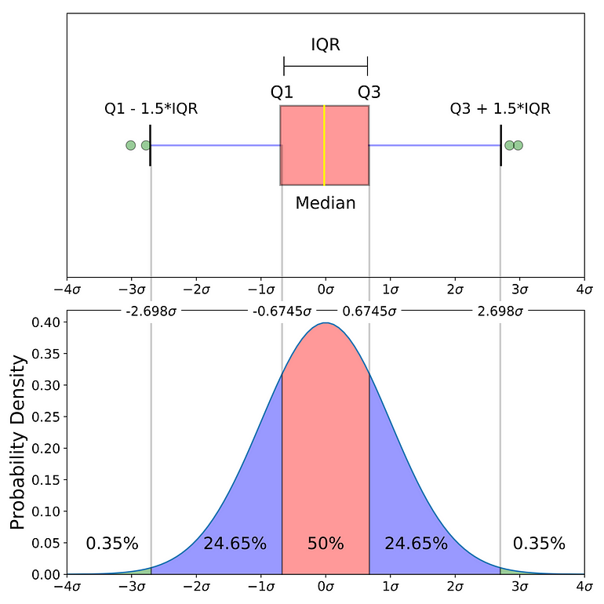

Slide 53
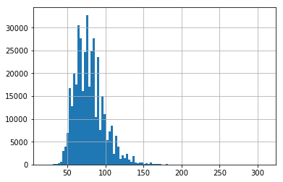
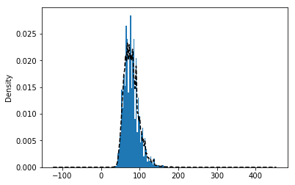
Other useful pandas plotting functions
Use kernel density estimate to approximate
the distribution with a mixture of normal distributions
hist, plot, scatter, etc.
In [1891]: df2['weight2'].hist(bins=100)
Out[1891]: <matplotlib.axes._subplots.AxesSubplot at 0x52197fd0>
In [1893]: df2['weight2'].hist(bins=100,normed=True); df2['weight2'].plot(kind='kde', style='k--')
Out[1893]: <matplotlib.axes._subplots.AxesSubplot at 0x53ddc828>

Slide 54
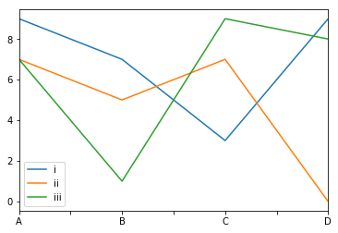
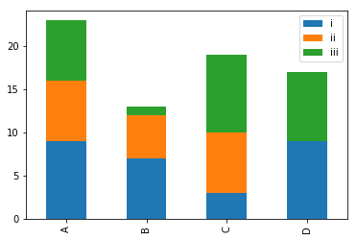
In [1911]: df3 = DataFrame(np.random.randint(0, 10, (4, 3)), index=['A', 'B', 'C', 'D'], columns=['i', 'ii', 'iii'])
In [1912]: df3.plot()
Out[1912]: <matplotlib.axes._subplots.AxesSubplot at 0x519a07b8>
In [1913]: df3.plot(kind='bar', stacked=True)
Out[1913]: <matplotlib.axes._subplots.AxesSubplot at 0x51afad68>

Slide 55
Why normalization (re-scaling)
 | Height (inches) | Heights (feet) | Heights (cm) | Weight (LB)
A | 63 | 5.25 | 160.0 | 150
B | 64 | 5.33 | 162.6 | 155
C | 72 | 6.00 | 182.9 | 156
A-B
In [1958]: distance(df6.loc['A',['inch','lb']],df6.loc['B',['inch','lb']])
Out[1958]: 5.0990195135927845
In [1959]: distance(df6.loc['A',['inch','lb']],df6.loc['C',['inch','lb']])
Out[1959]: 10.816653826391969
In [1960]: distance(df6.loc['B',['inch','lb']],df6.loc['C',['inch','lb']])
Out[1960]: 8.06225774829855
A-C
B-C
In [1961]: def distance(ser1, ser2): return ((ser1-ser2)**2).sum()**0.5
A-B
In [1963]: distance(df6.loc['A',['foot','lb']],df6.loc['B',['foot','lb']])
Out[1963]: 5.000639959045242
In [1964]: distance(df6.loc['A',['foot','lb']],df6.loc['C',['foot','lb']])
Out[1964]: 6.046693311223912
In [1965]: distance(df6.loc['B',['foot','lb']],df6.loc['C',['foot','lb']])
Out[1965]: 1.2037026210821342
A-C
B-C

Slide 56
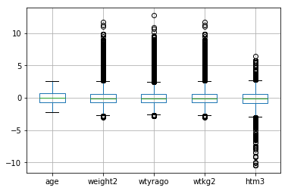
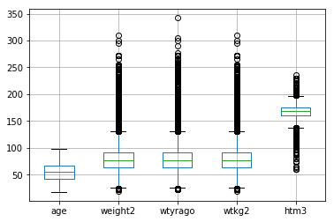
Z-score transformation
In [1931]: def zscore(series): return (series - series.mean(skipna=True)) / series.std(skipna=True);
In [1932]: df5 = df4.apply(zscore)
In [1933]: df5.boxplot()
Out[1933]: <matplotlib.axes._subplots.AxesSubplot at 0x51e52ac8>
In [1929]: df4 = df.drop('sex', axis=1)
In [1930]: df4.boxplot()
Out[1930]: <matplotlib.axes._subplots.AxesSubplot at 0x51e9cb00>

Slide 57
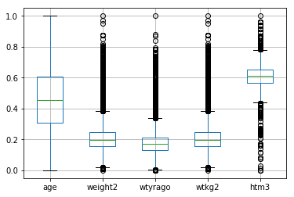
Scaling to between 0 and 1
In [2181]: def scaling(series):
return (series - series.min()) / (series.max() - series.min())
In [2182]: df7 = df4.apply(scaling)
In [2183]: boxplot(df7)

Slide 58
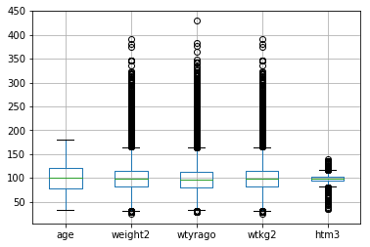
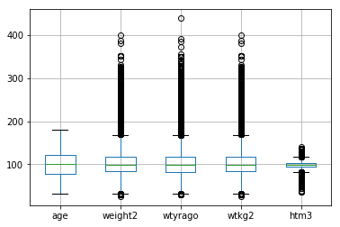
Mean-based scaling
In [2229]: def trimMeanScale(series, proportionToCut=0):
...: return series / stats.trim_mean(series.dropna(), proportionToCut)
In [2230]: df8 = df4.apply(trimMeanScale, proportionToCut=0.1)*100
In [2231]: df8.boxplot()
In [2188]: def meanScaling(series):
...: return series / series.mean()
...: df8 = df4.apply(meanScaling) * 100
...: df8.boxplot()
...:
Mean after removing largest and smallest proportionToCut data

Slide 59
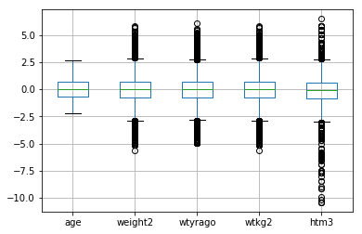
Transform and normalize
In [2242]: df9 = df4.transform({'age': np.copy, 'weight2': np.log, 'wtyrago': np.log, 'wtkg2': np.log, 'htm3': np.copy})
In [2243]: df10 = df9.apply(zscore);
In [2244]: df10.boxplot()
Transform each column with a different function

